Slide 1
Digital Logic Design
CSE 232 Computer Systems Fundamentals
Dr. Gamal Fahmy
Registers and Counters
© Gamal Fahmy

Slide 2
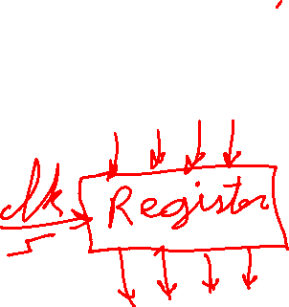
Registers
Registers are made up of multiple D flip-flops and stores a number of bits
Counters are a special kind of registers that go through a series of steps
© Gamal Fahmy

Slide 3
Registers
Build a 2-bit shift register. (Note the asynchronous set/reset inputs.)
S
Q
Q
S
Q
Q
1=
D_{IN}
D
Clk
0
1
1
D
Clk
0
0
1
Clock
R
R
© Gamal Fahmy

Slide 4
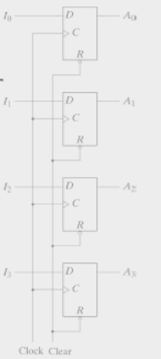
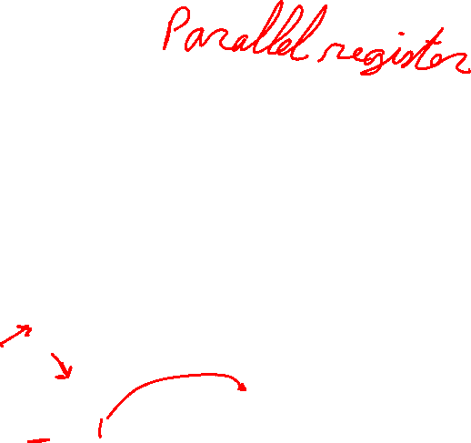
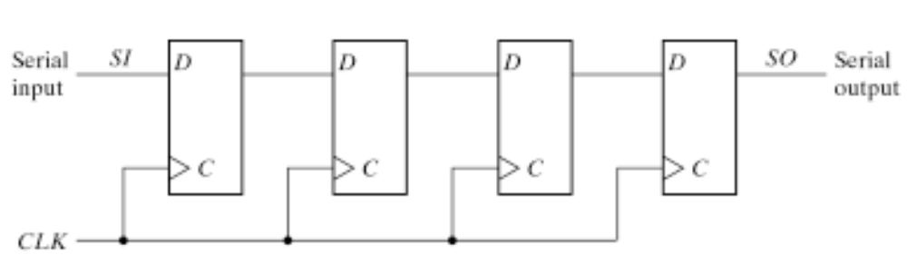
Registers
© Gamal Fahmy
Slide Taken from Dr Kareem Darwish

Slide 5

Ripple Counter
Now that we have flip-flops for memory, we can start to design more interesting circuits.
The first circuit we’ll design is an asynchronous counter called a ripple counter.
Defn: Counter - a sequential circuit that goes through a set of given states on successive clock cycles.
© Gamal Fahmy

Slide 6
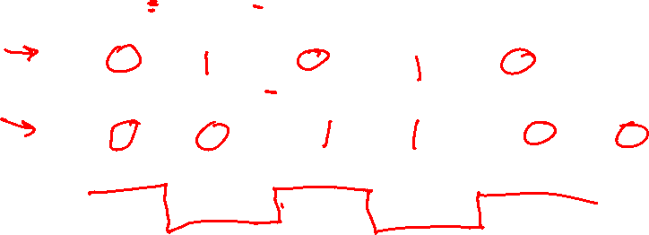
Ripple Counter
Let’s assume we want a 2-bit ripple counter that counts up, i.e., 00, 01, 10, 11, 00.
What should the timing diagram look like for the outputs of this counter?
Clk
Q₀
Q₁
T₁, (0,1)
T₂, (1,0)
T₃, (1,1)
T₄, (0,0)
T₀
Count=(0,0)
© Gamal Fahmy

Slide 7
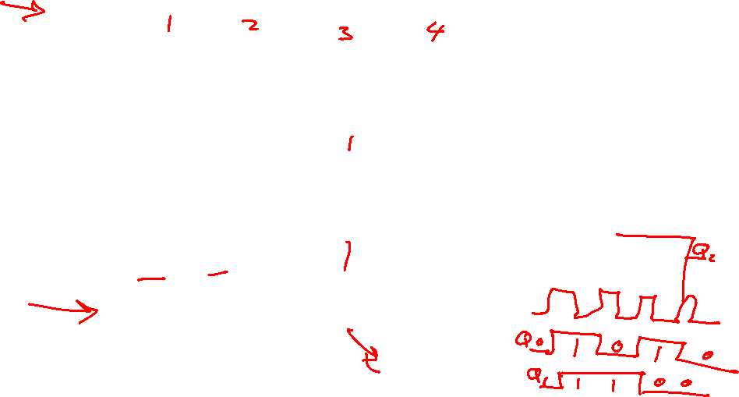
Q0 changes on every
clock pulse. Q1 on every
other clock pulse.
Ripple Counter
(0,0)
(0,1)
(1,0)
(1,1)
(0,0)
Clk
Q₀
Q₁
Q₀
Q₀
Q₀
Q₁
Q₁
1
T
Clk
1
T
Clk
This counter is also called a divide by 4 counter. Why?
T
Flip Flop
T
Flip Flop
Clk
© Gamal Fahmy

Slide 8
Ripple Counter
It is easy to get divide-by-2^{k} counters following the same design method.
Q:How can we get a divide-by-3 counter?
A: Count 00, 01, 10, then reset immediately at 11.
© Gamal Fahmy

Slide 9
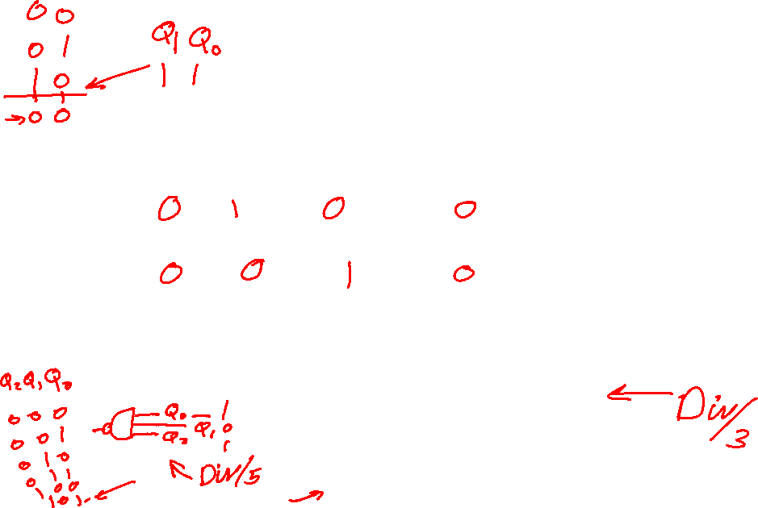
Ripple Counter
(0,0)
(0,1)
(1,0)
(0,0)
(0,1)
Clk
Q₀
Q₁
Q₀*Q₁
1
T Q₀
Clk
Q₀
Reset
1
T Q₁
Clk
Q₁
Reset
Clk
Q₀
Q₁
© Gamal Fahmy

Slide 10
Ripple Counter
There are several limitations to ripple counters:
  Large count values will have significant delay times from clocking event to last bit change.
  Outputs do not change in synchronism.
We can correct this with synchronous counters.
Also with synchronous counters we will find it easy to change the count sequence.
© Gamal Fahmy

Slide 11
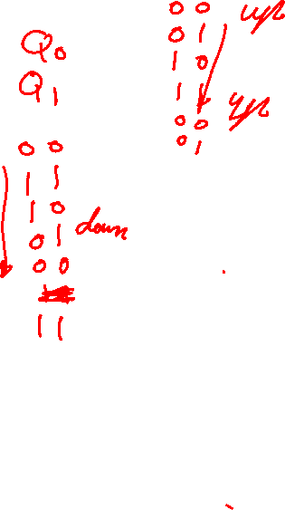
Ripple Counter
Gray Code
Counter
00
01
11
10
Gray Code
Counter
000
001
011
010
110
111
101
100
Gray Code
Counter
0000
0001
0011
0010
0110
0111
0101
0100
1100
1101
1111
1110
1010
1011
1001
1000
3-Bit Binary
Counter
000
001
010
011
100
101
110
111
000
etc.
Down
Counter
Up
Counter
Binary
Coded
Decimal
0000 (0)
0001 (1)
etc.
1001 (9)
Check last week’s example
© Gamal Fahmy

